Slide 1
Universal Marketing
Power BI Capstone

Slide 2
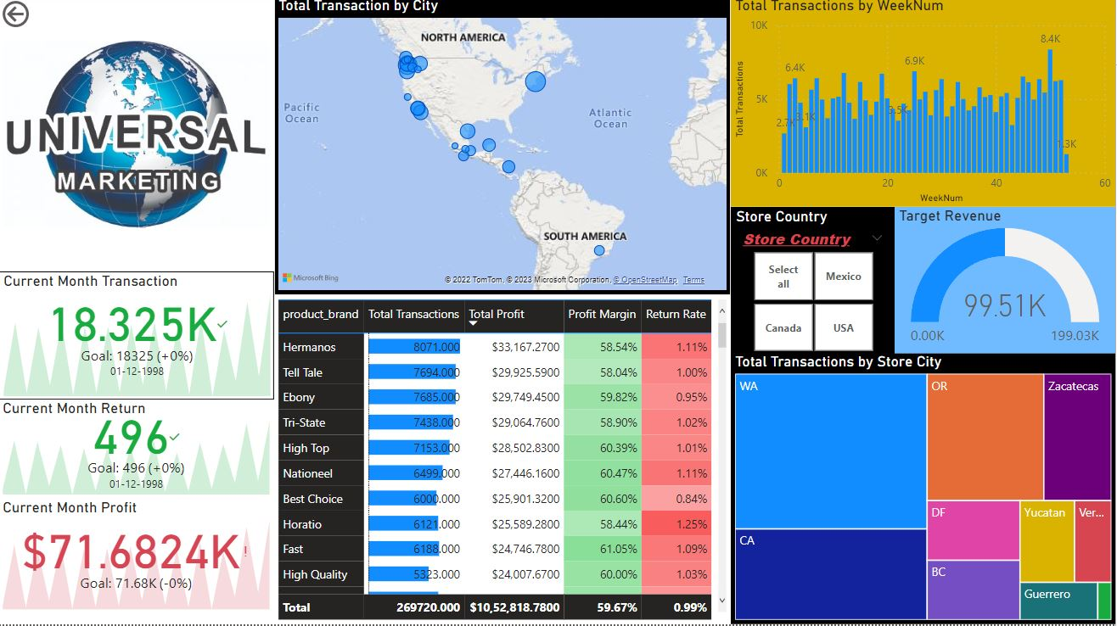
Post Visualization Presentation

Slide 3
Types of Visualizations Used
Cards
Matrix
Tree Map
Slicers
Map
Organization image
Stacked column chart

Slide 4
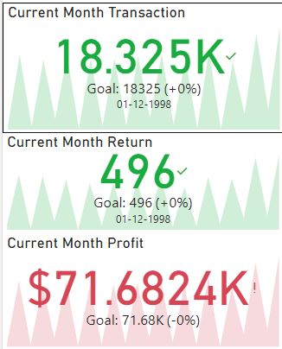
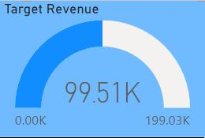
Types of Visualizations Used
Cards
Cards

Slide 5
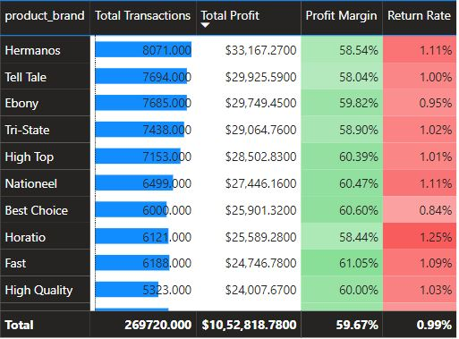
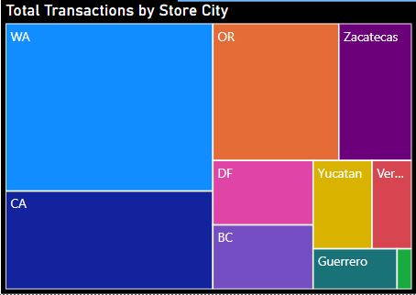
Types of Visualizations Used
matrix
Tree map

Slide 6
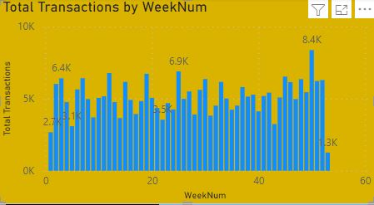
Types of Visualizations Used
Stacked column chart
slicers

Slide 7
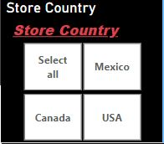

Types of Visualizations Used
Slicers
Organizational image

Slide 8
Types of Functions Used
Text functions
Date functions
STATISTICAL FUNCTIONS
Logical functions
Time functions
Statistical functions

Slide 9
Types of Functions Used
Date Functions :- date datediff DATEADD DAY MONTH YEAR EOMONTH
TIME FUNCTIONS:- HOUR MIN NOW TIME TIMEVALUE

Slide 10
Types of Functions Used
TEXT FUNCTIONS :- LEFT LEN UPPER SEARCH REPLACE TRIM
STATISTICAL FUNCTIONS:- COUNT SUM MAX MIN AVG SUMX COUNTX

Slide 11
Types of Functions Used
LOGICAL FUNCTIONS :- AND OR IF IN SWITCH TRUE FALSE
STATISTICAL FUNCTIONS:- COUNT SUM MAX MIN AVG SUMX COUNTX

Slide 12
Data Sets Used
Calendar
customers
products
Regions
RETUNR DATA
STORes

Slide 13
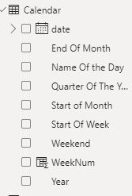
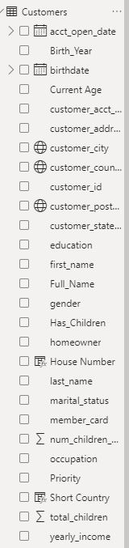
Data Sets Used
Calendar
Customers

Slide 14
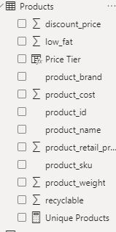
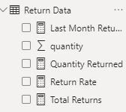
Data Sets Used
PRoducts
Return data

Slide 15
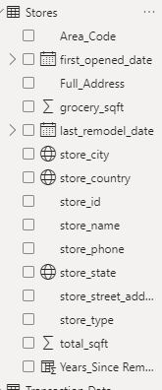

Data Sets Used
Regions
stores

Slide 16
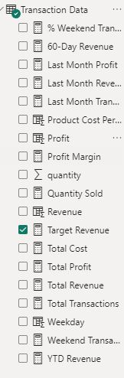
Data Sets Used
Transactions

